Slide 1
App: Employee Management
By Umair Rashid

Slide 2
Description
An Application to help you manage your employees.
The application can:
Add Employees to the Database
View Employee Information
Remove Employee Information
Update Employee Information
Additional Tool: Wage Calculator

Slide 3
Motivation
I love developing meaningful application
Databases are huge part of the business and I wanted to develop an application that interacts with the database.
I want to develop application that can be useful for future Businesses.

Slide 4
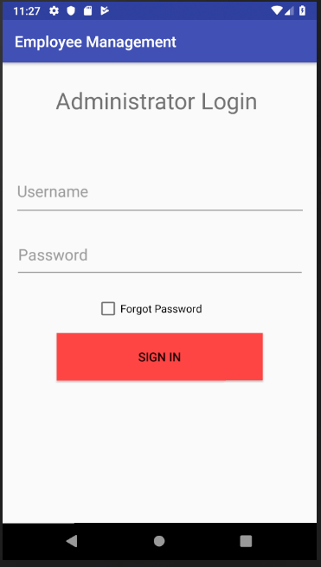
Login Page
Login Page for the Administrator
Credentials Needed
Username(9-digit Number)
Password
Features
Security
Username validation(Checks if the user entered 9 digits, and if not then displays Invalid Username)

Slide 5
Login Page(Continued)
Features
Animations
Forgot Password
Changes the button text to “Forgot Password?”
Animates and removes the password field
Creates an email to tech Admin of the application to request a password reset

Slide 6
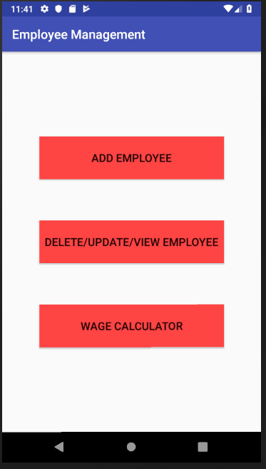
Main Page(After Successful Login)
Main Page will have the following buttons to navigate:
Add Employee
Delete/Update/View Employee
Wage Calculator

Slide 7
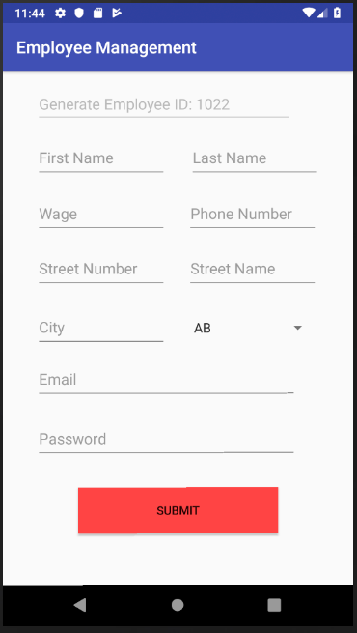
Add Employee
Add Employee will allow the user to add employee to the database.
Employee Information:
First Name
Last Name
Wage Per Hour
Phone Number
Street Number
Street Name
City
Province
Email
Password

Slide 8
Add Employee(Continued)
Features:
Provinces spinner
Auto-generated Employee ID based on the employee database
Following data validation:
All fields must be filled
Wages must be between 10 and 100
Phone number will only have 10-digits
Password should be greater than equal to 8 characters
A valid email should be entered

Slide 9
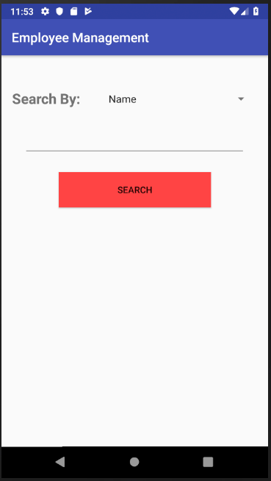
Delete/View/Update
User can delete, view or update employee information from this section
User can search by two options:
By Name
By Employee ID
Once the user selects and search for the employee some new options are displayed

Slide 10
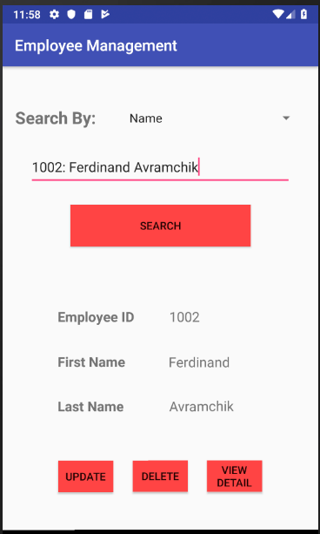
Delete/View/Update(Continued)
After Searching the following information is displayed:
Employee ID
First Name
Last Name
Following options are also displayed:
Update
View
Detail

Slide 11
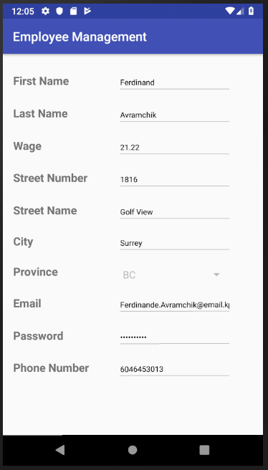
Delete/View/Update(Delete and View)
If the user selects DELETE option, then the employee will be removed from the database and confirmation will be displayed
If the user selects VIEW option, it can see all the information about the user
The information is only for viewing purposes
No changes can be made here

Slide 12
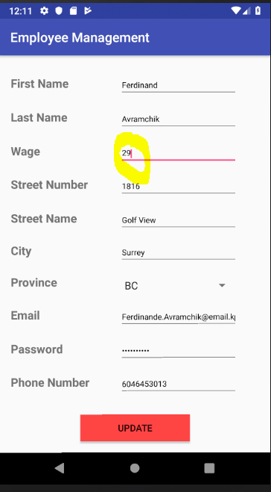
Delete/View/Update(Update)
If the user selects UPDATE option, it can see all the information about the user in EditText fields.
The user can choose to edit the information it wants and leave the rest as it is in the database
Update Button is also displayed
Once the user updates the data, then the data is validated using the same criteria as when the data was entered

Slide 13
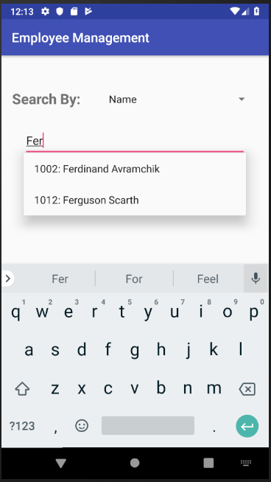
Delete/View/Update(Features)
Auto Complete Name or ID based on selection
Data Validation for Searching and Update option
One section can do it all: UPDATE, VIEW AND DELETE employees.

Slide 14
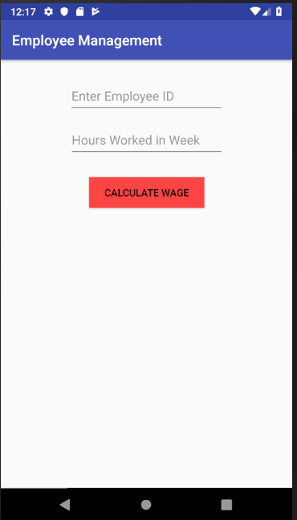
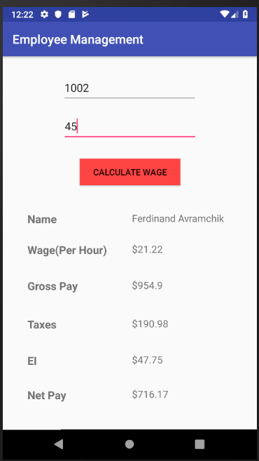
Wage Calculator(Additional Tool)
An additional tool to calculate wages
Users can enter the employee ID in the auto complete search bar and enter the hours worked
Max hours < 50 and minimum is > 30
Display error if we enter an invalid ID or exceed the hour range.

